Slide 1
3 - vehicle_safety_final (Impute)

Slide 2
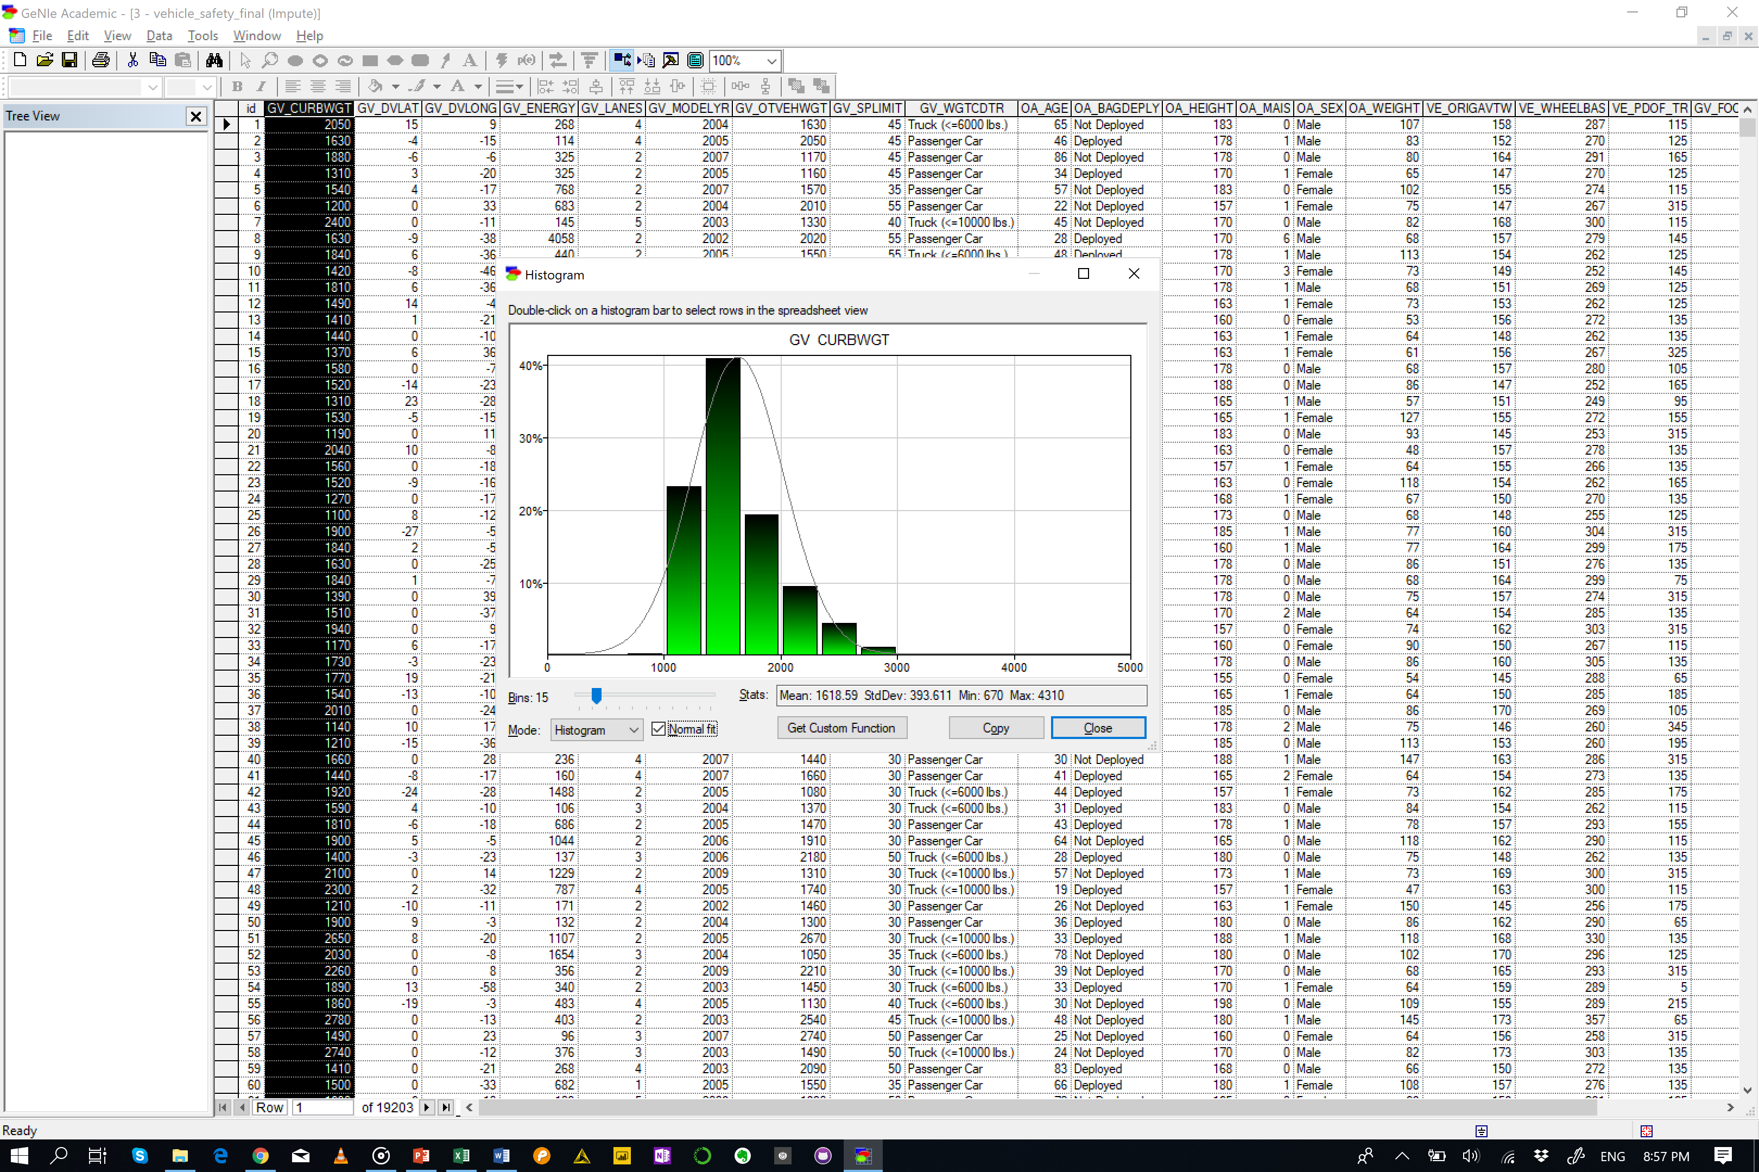
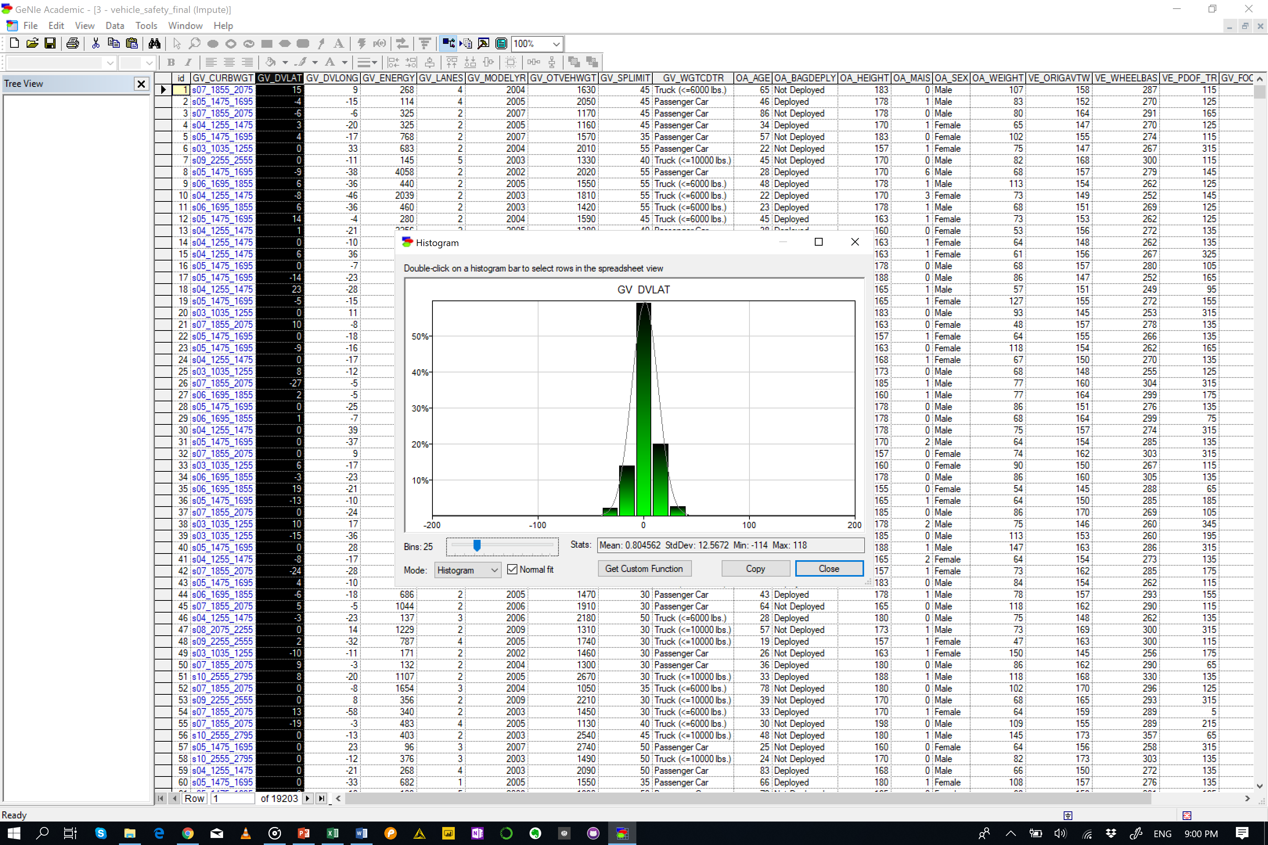
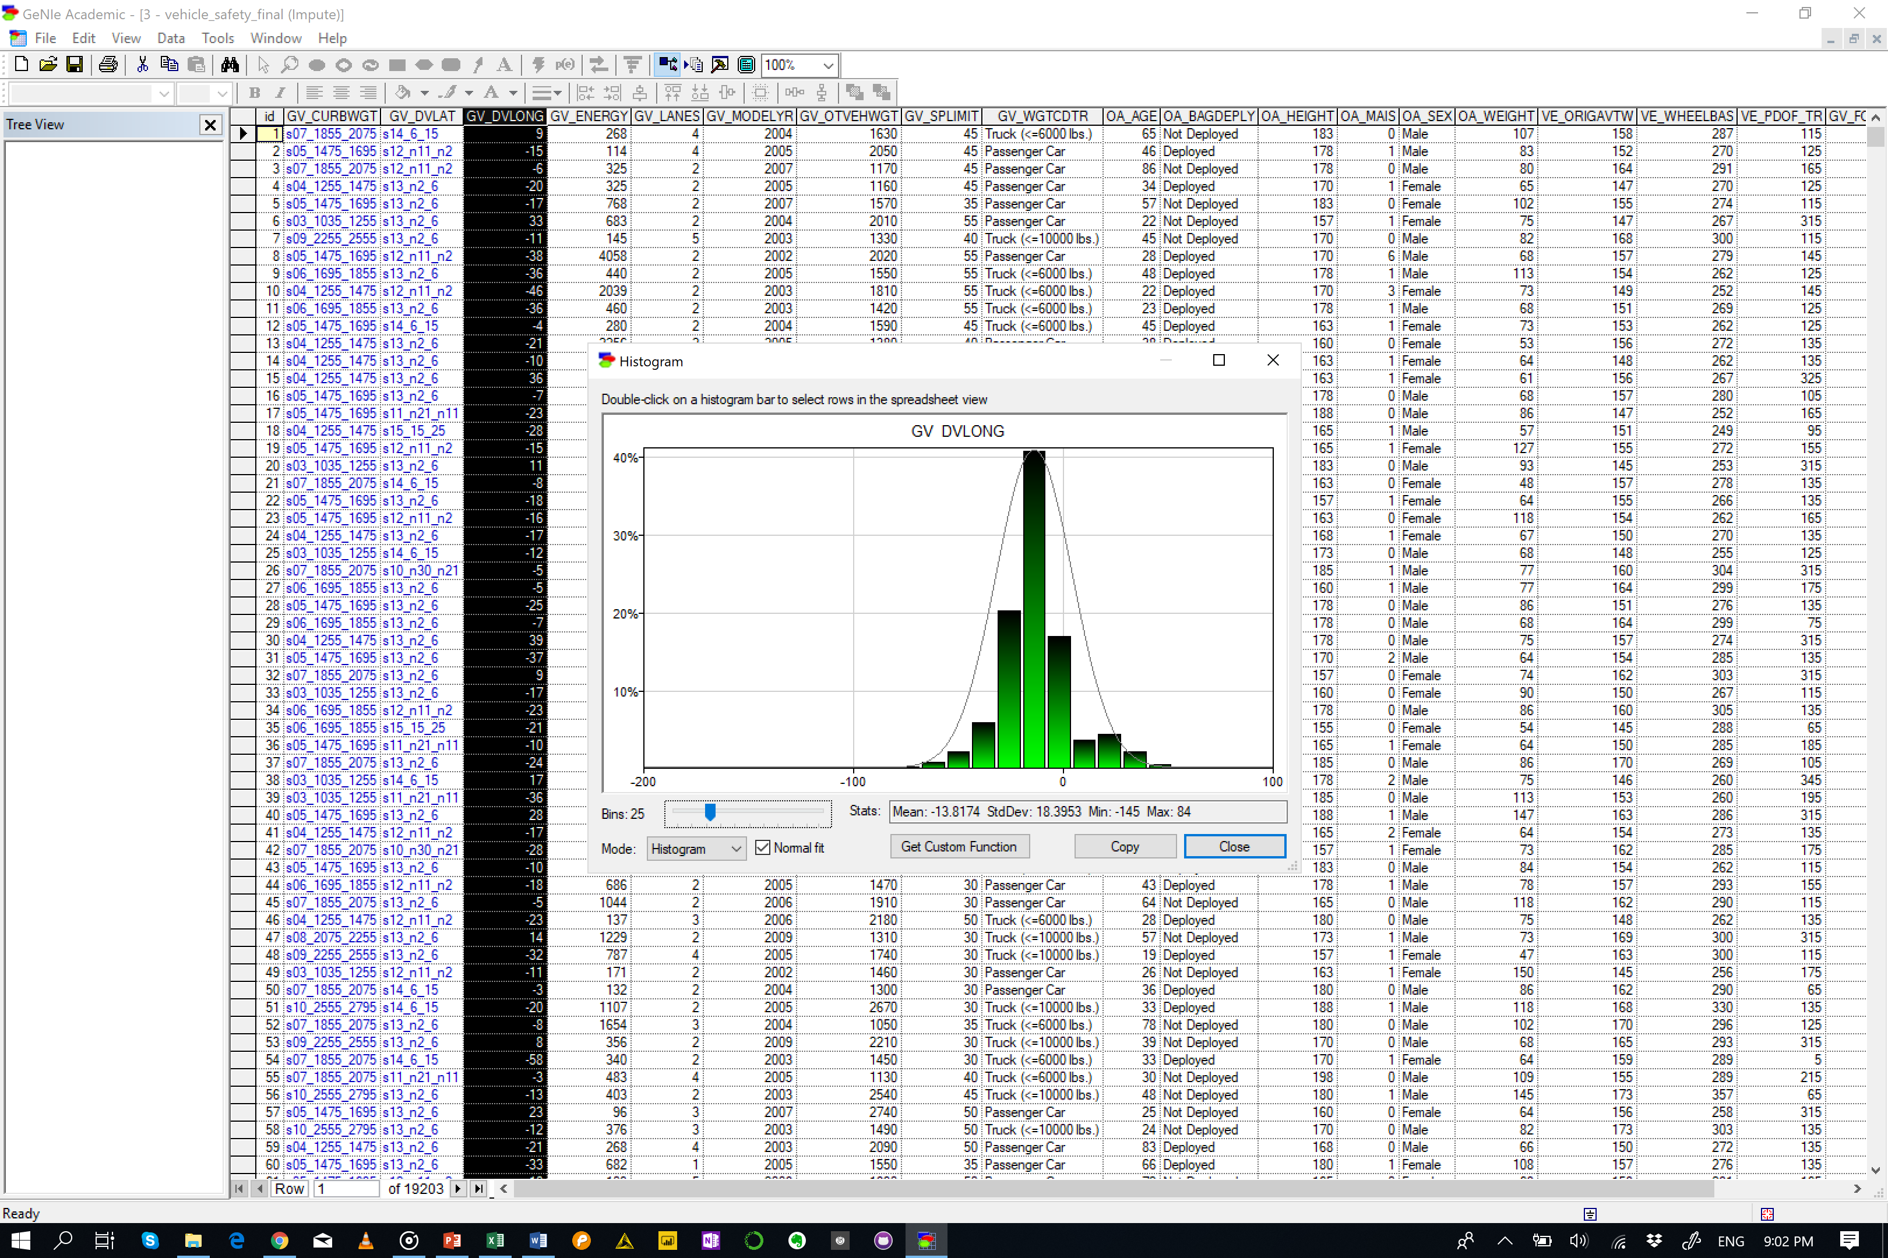
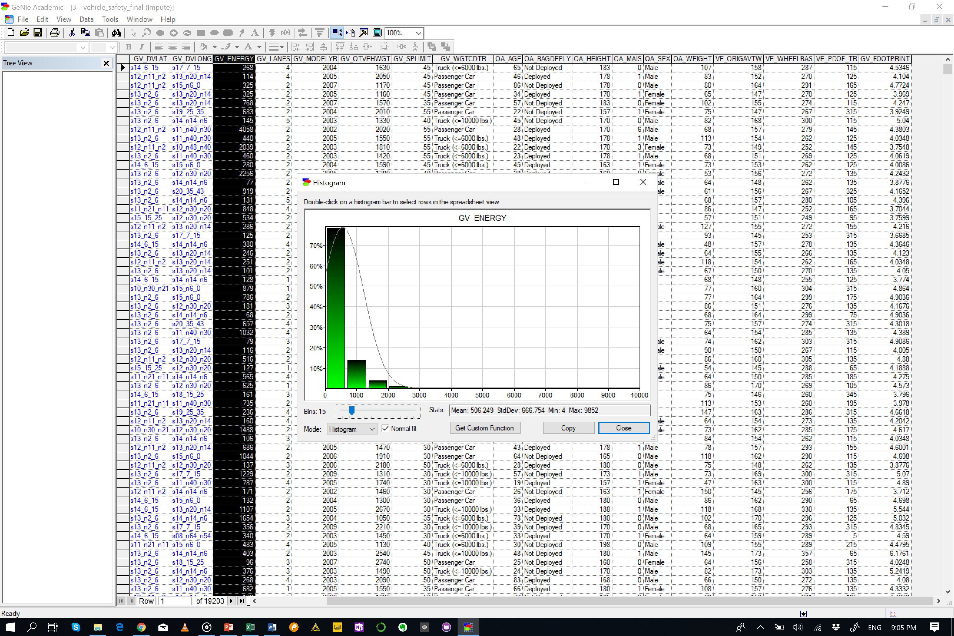
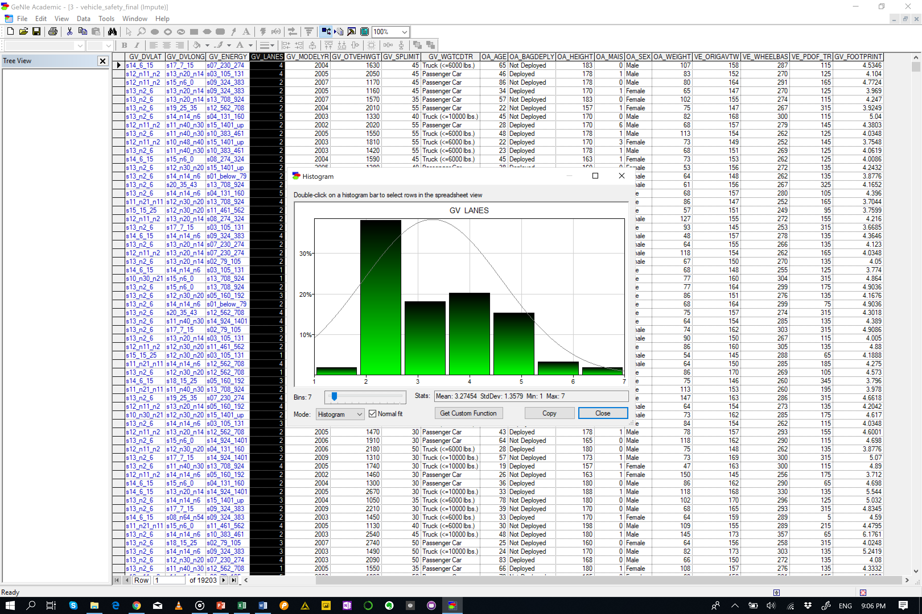
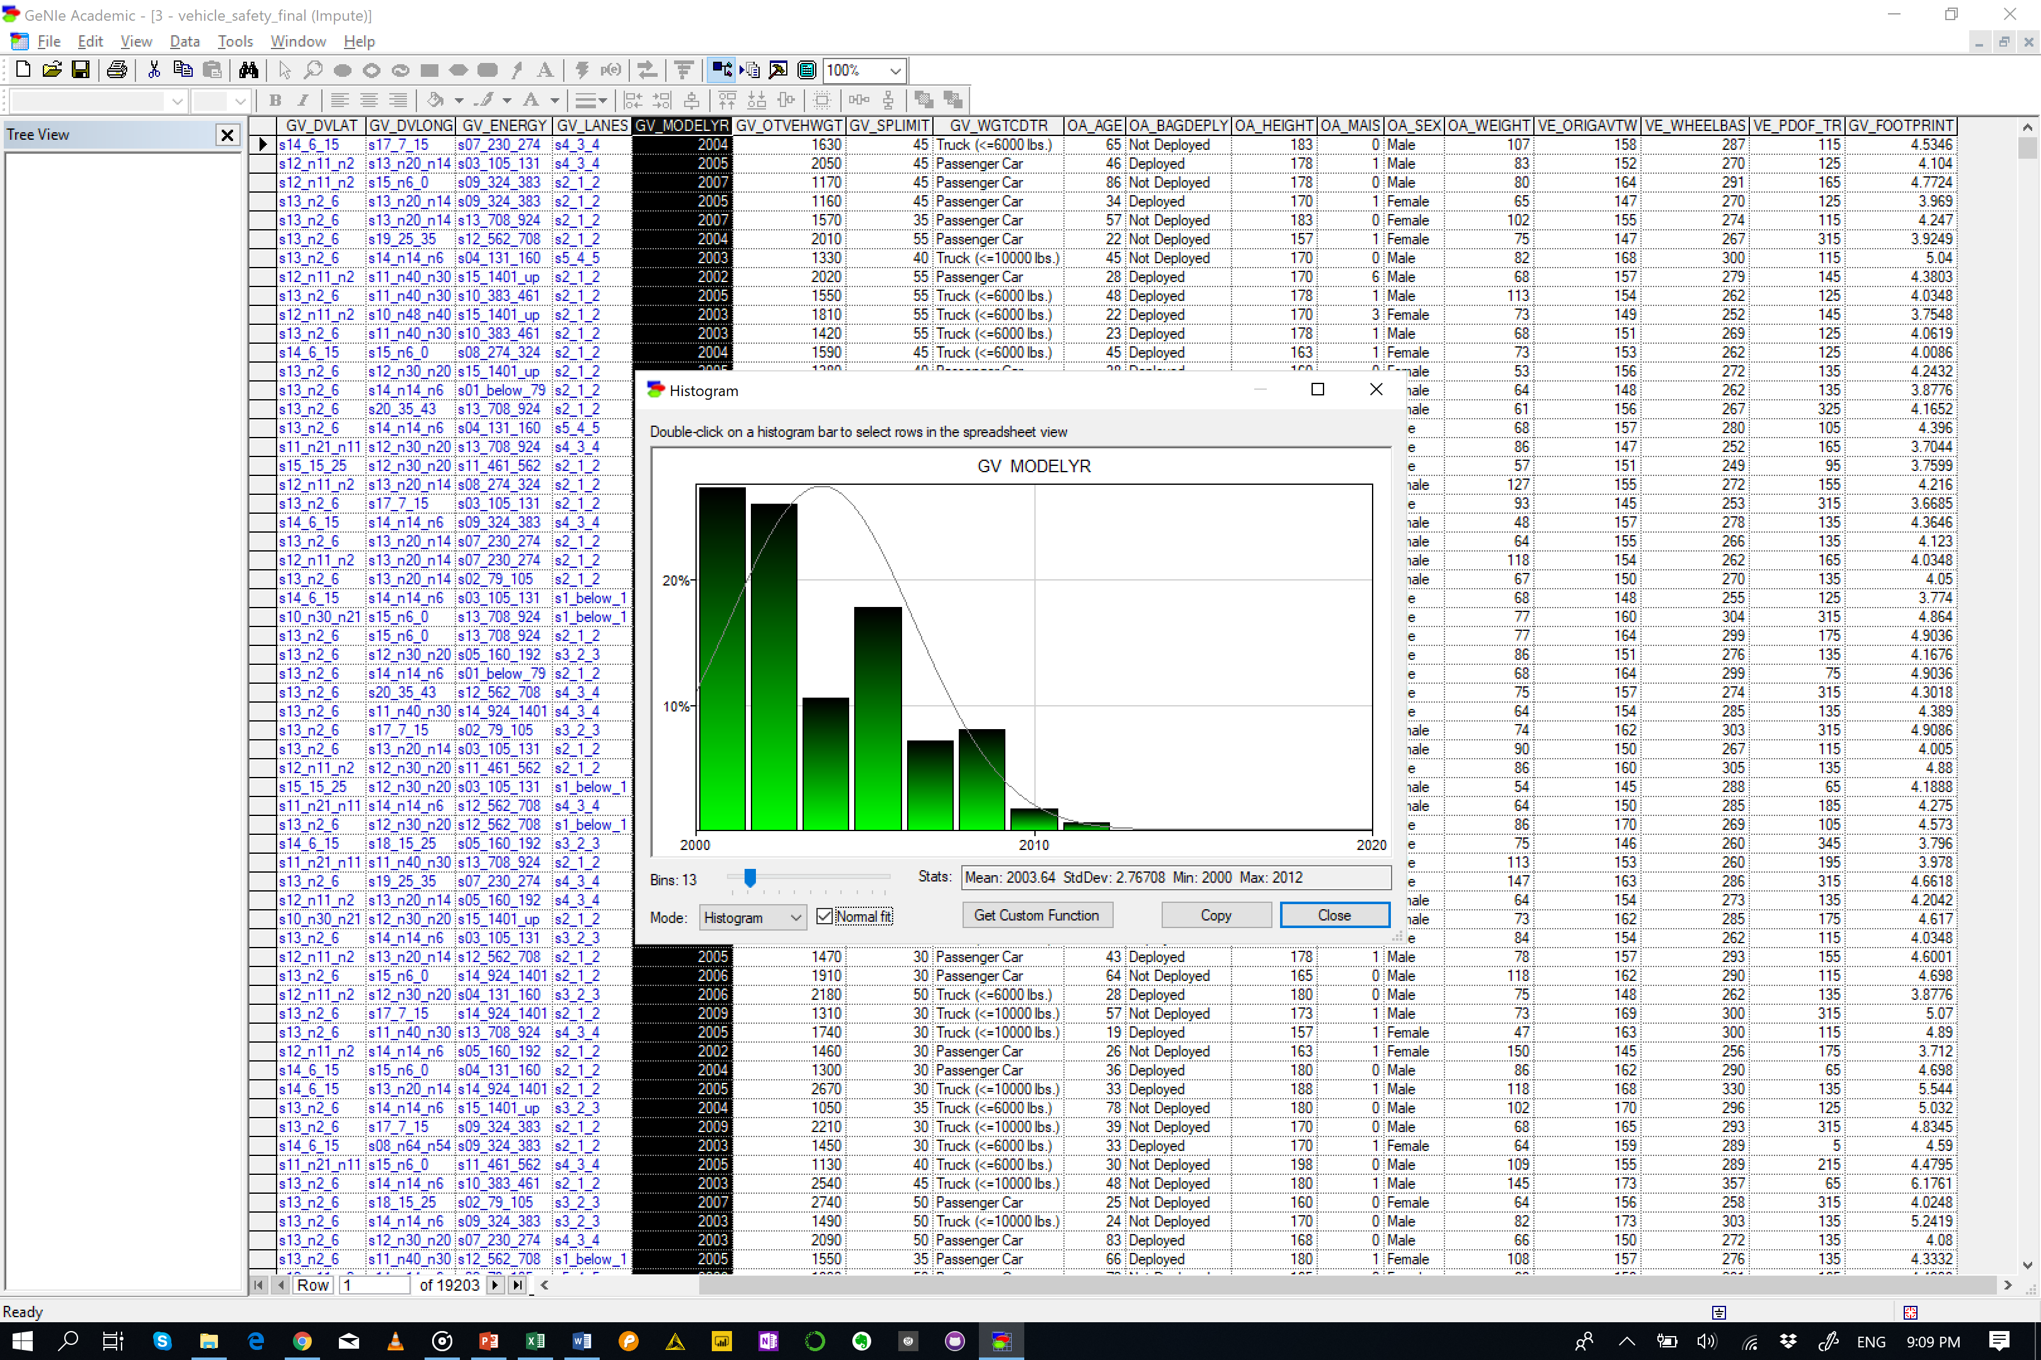
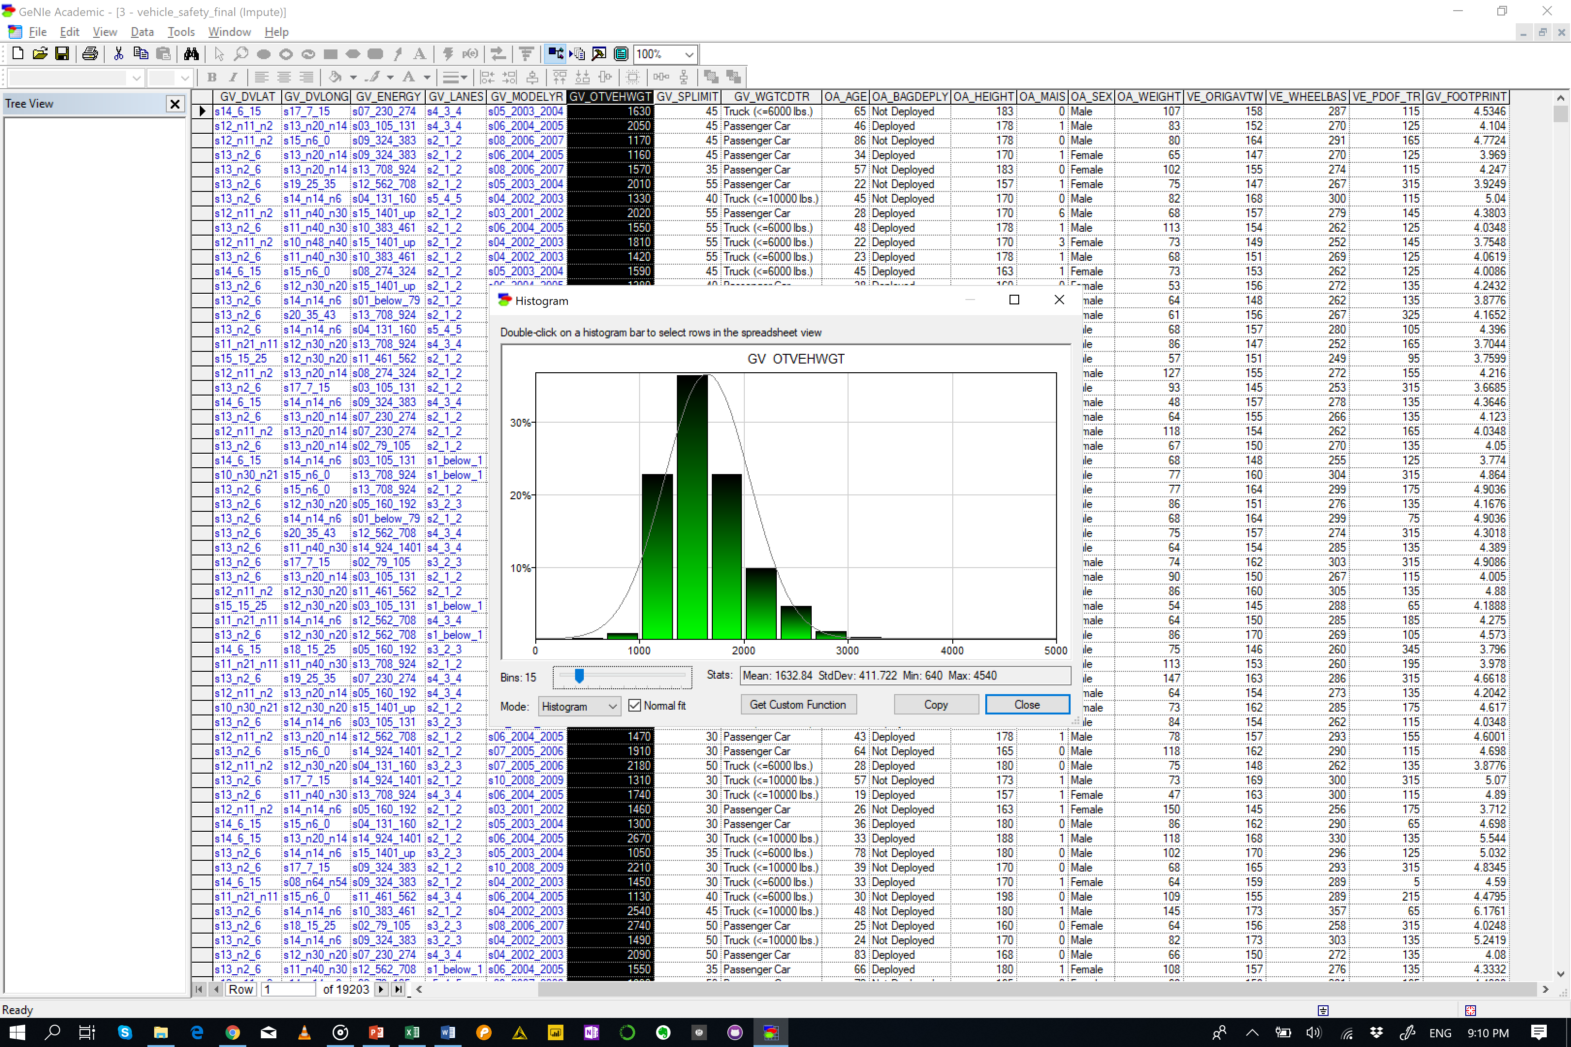
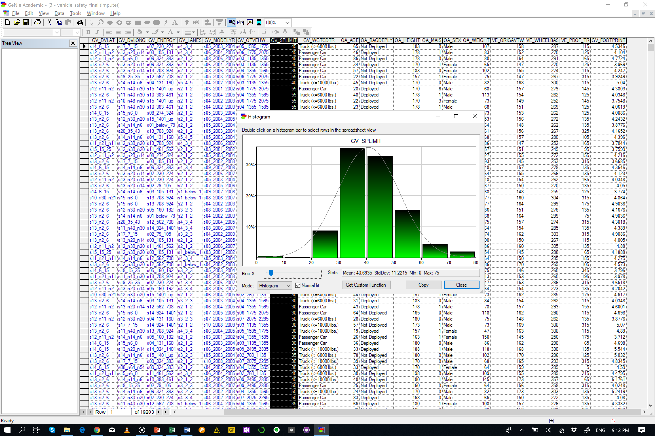
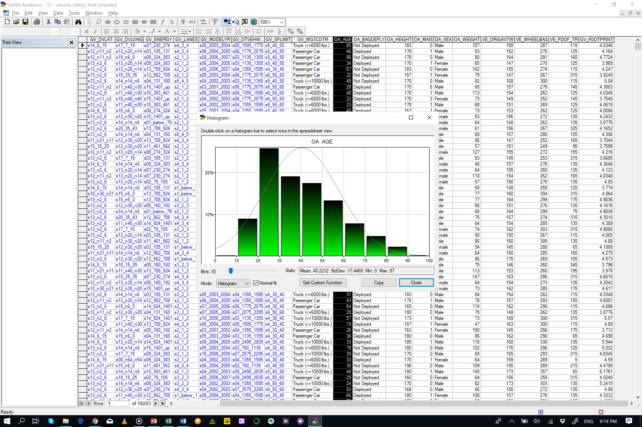
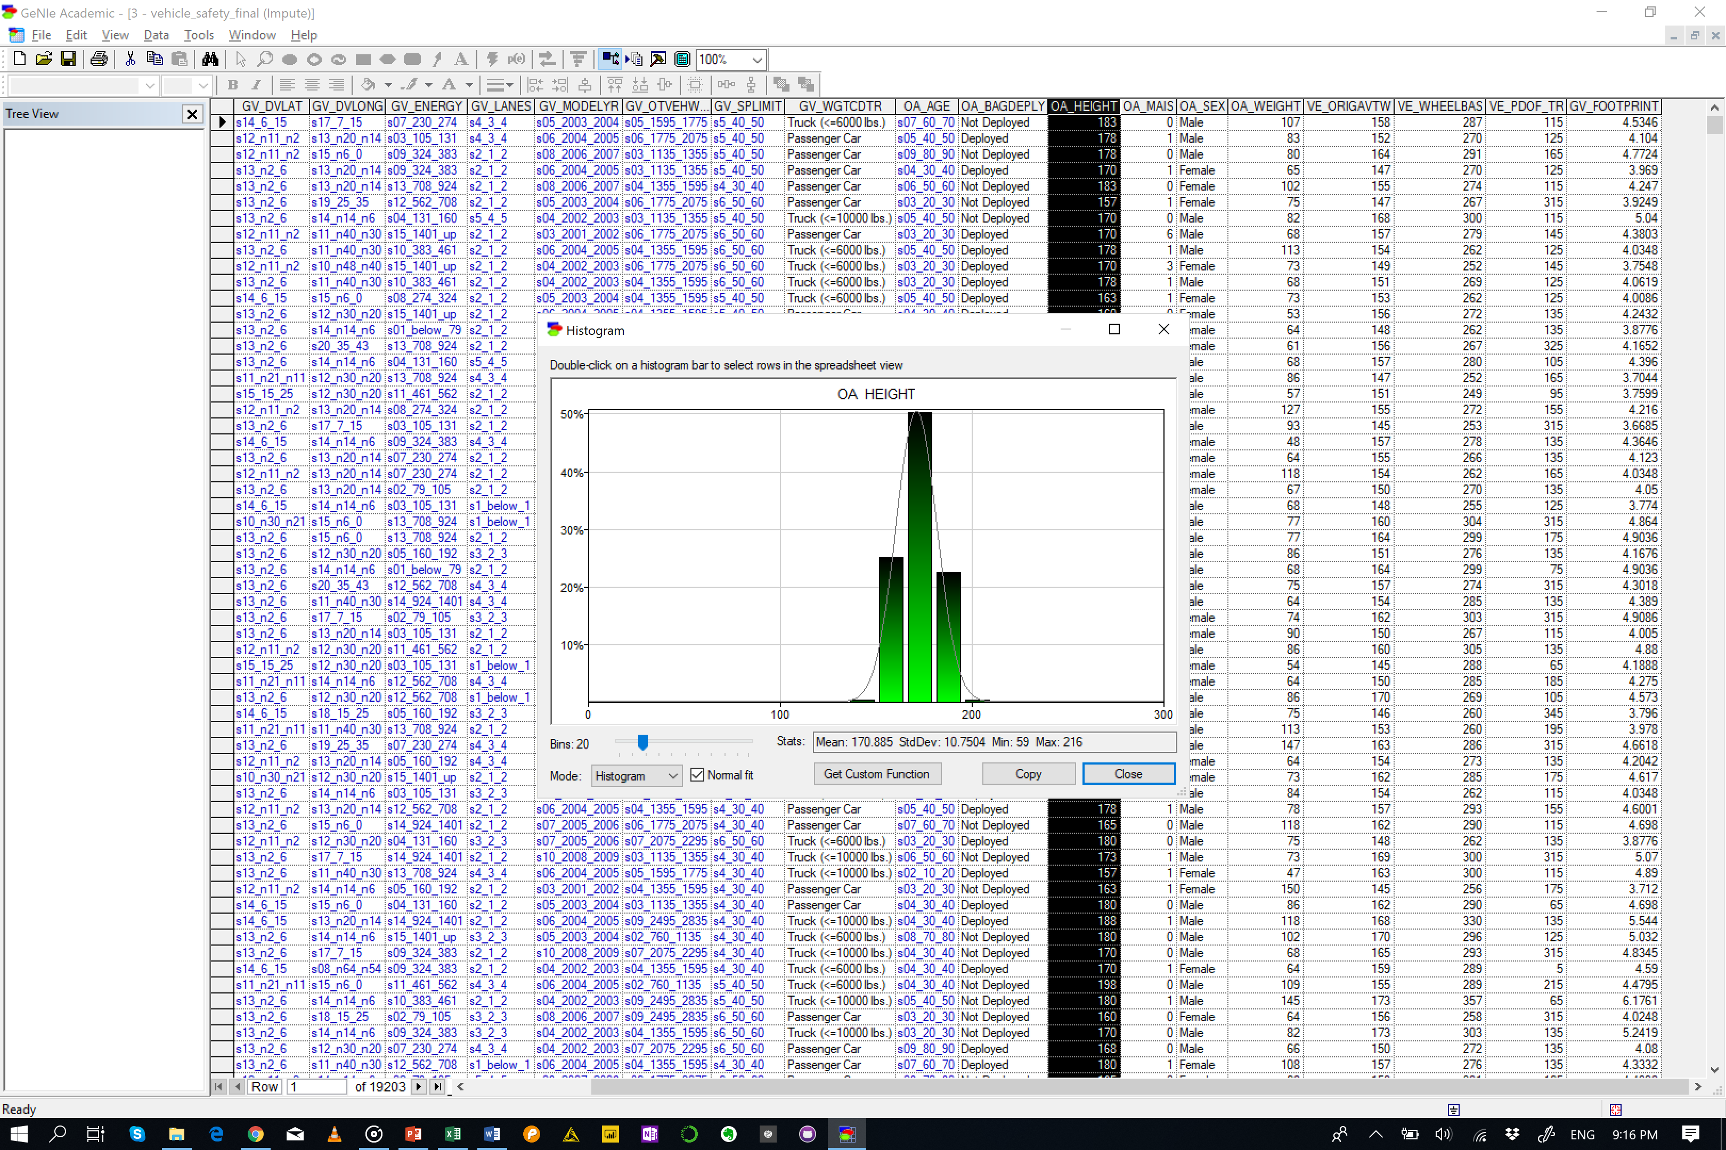
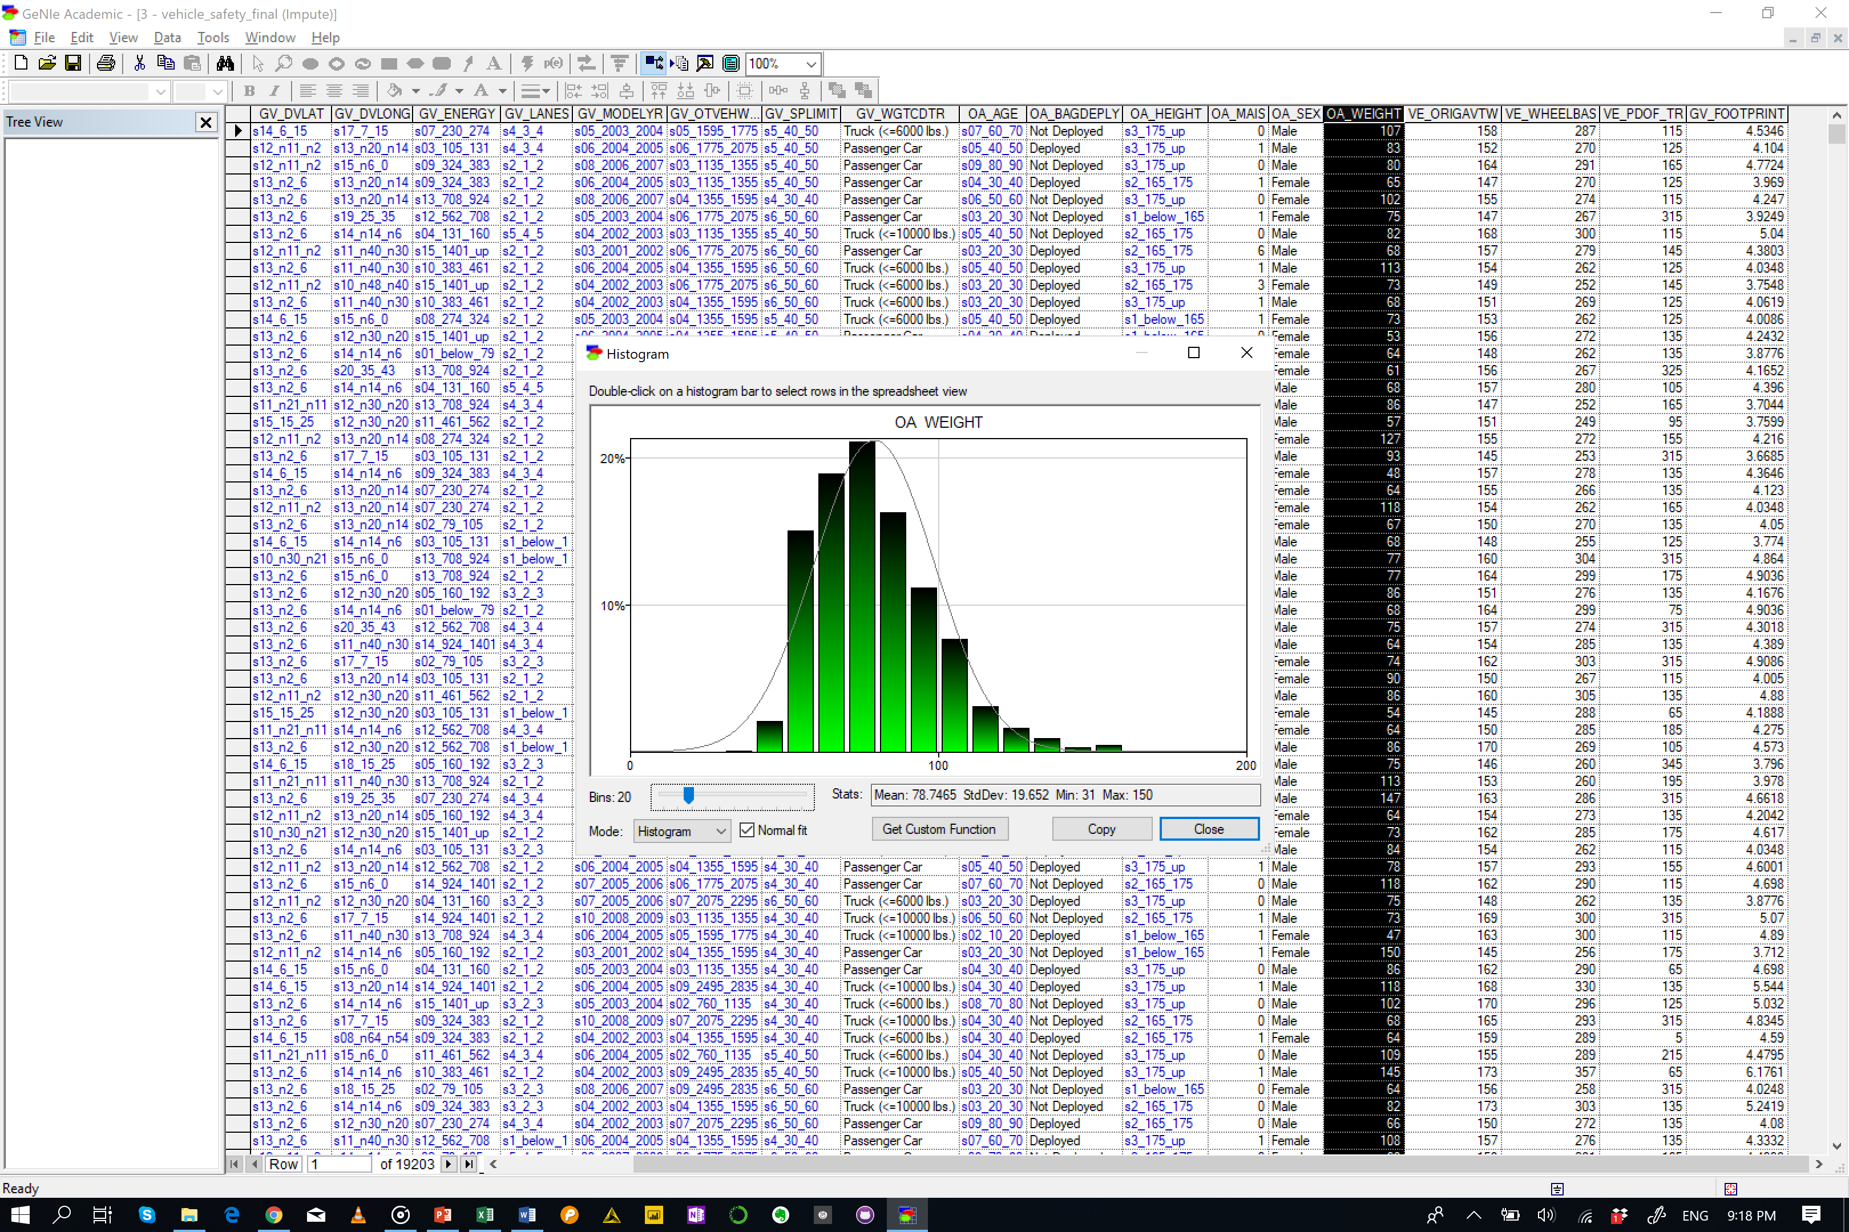
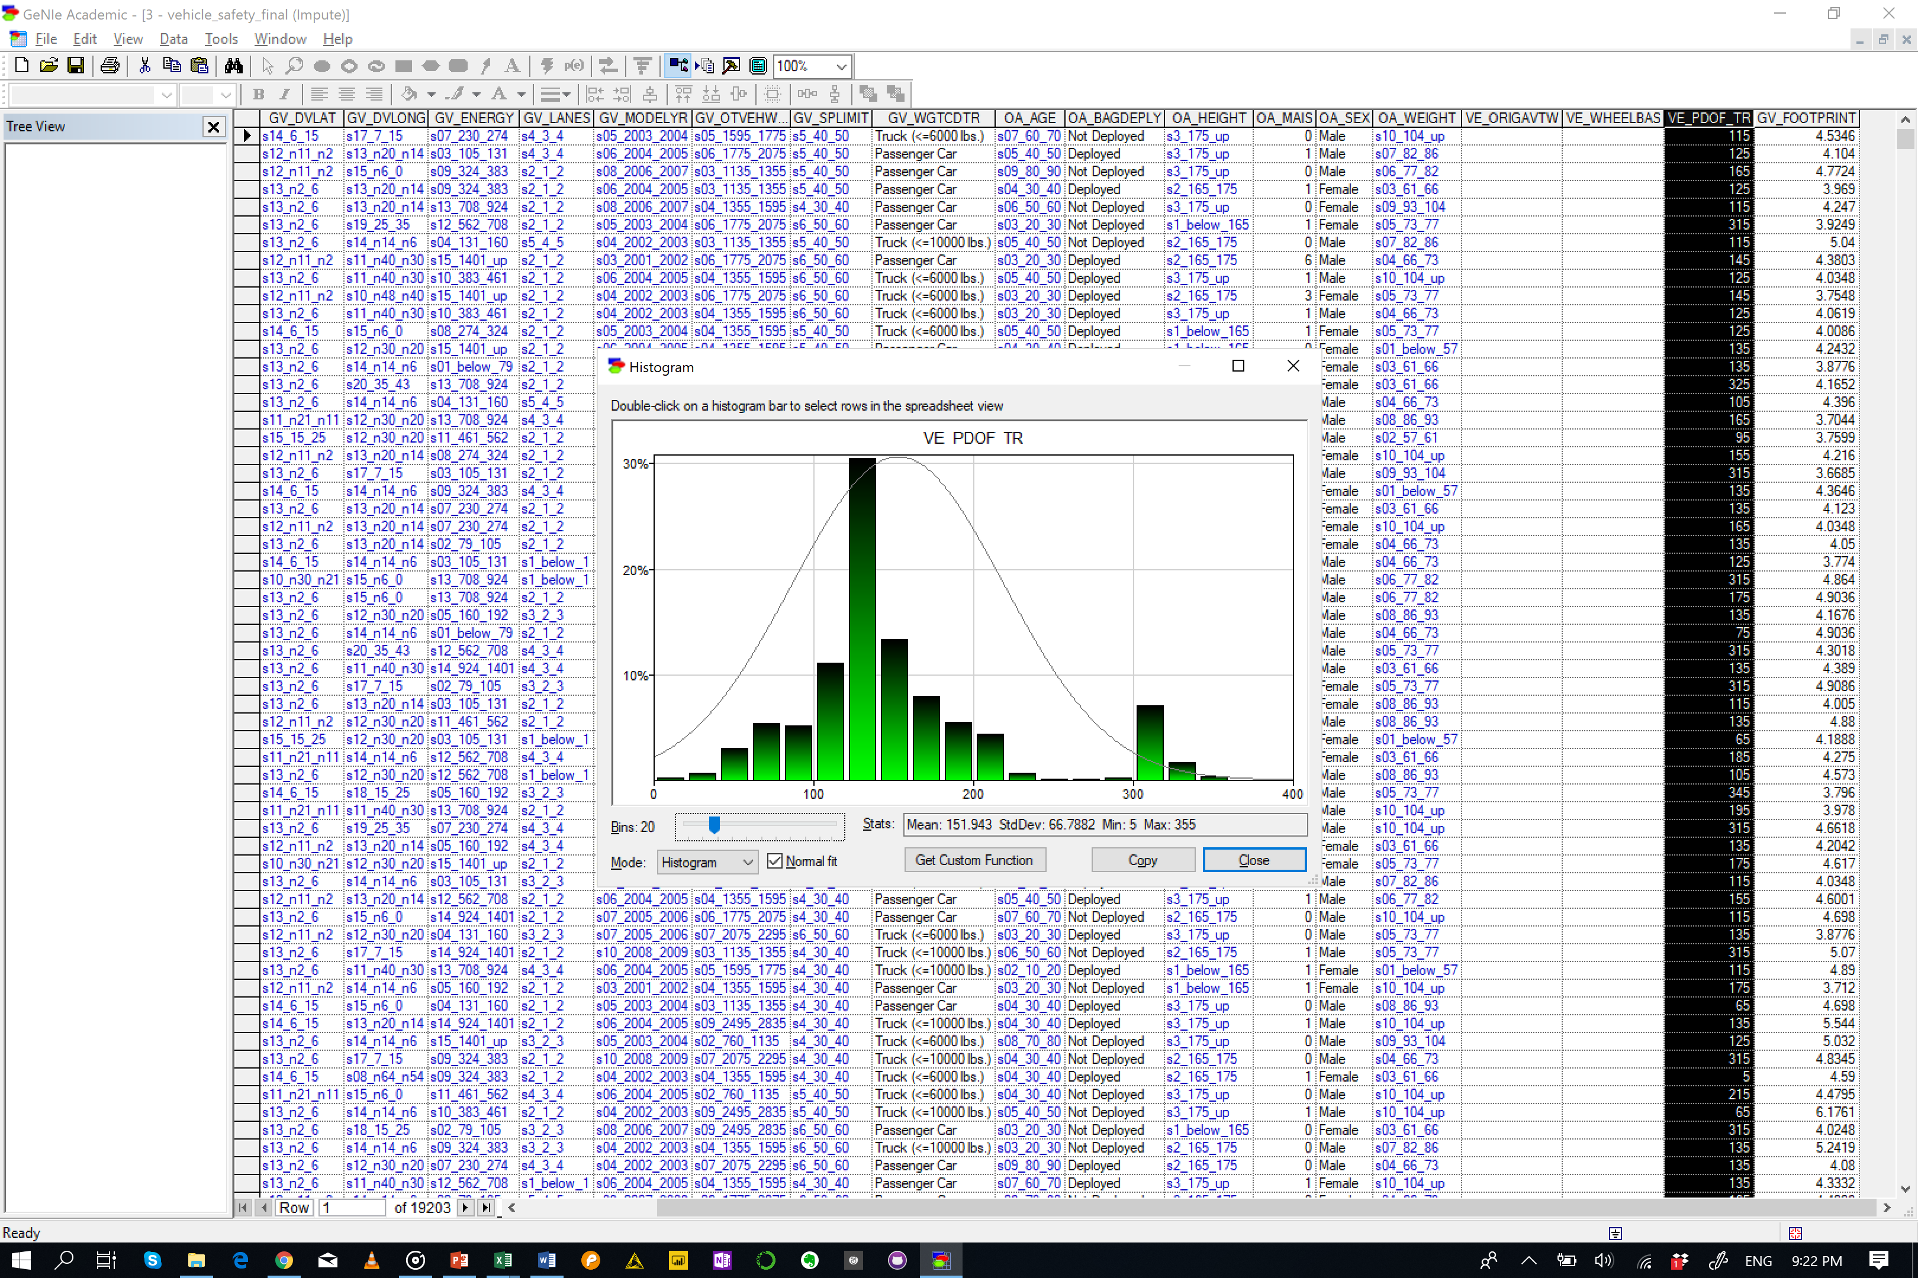
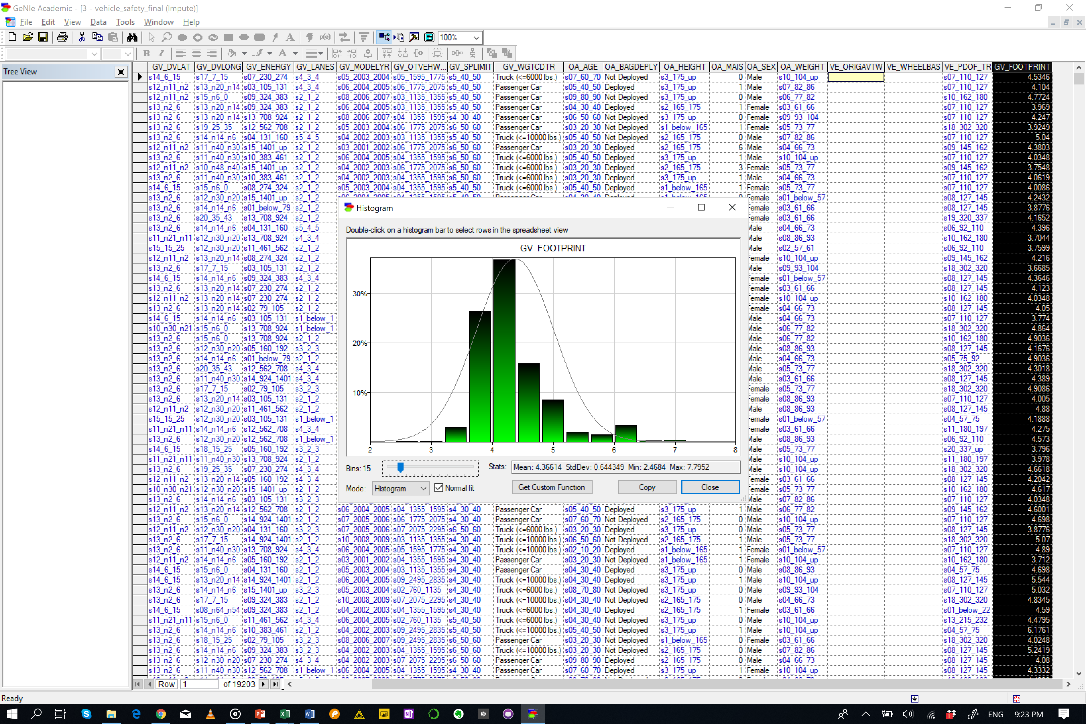
Removed
VE_ORIGAVTW
VE_WHEELBAS

Slide 3
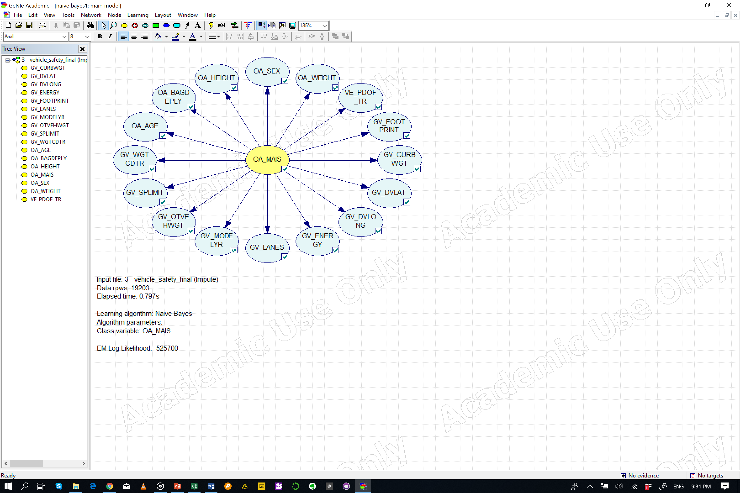
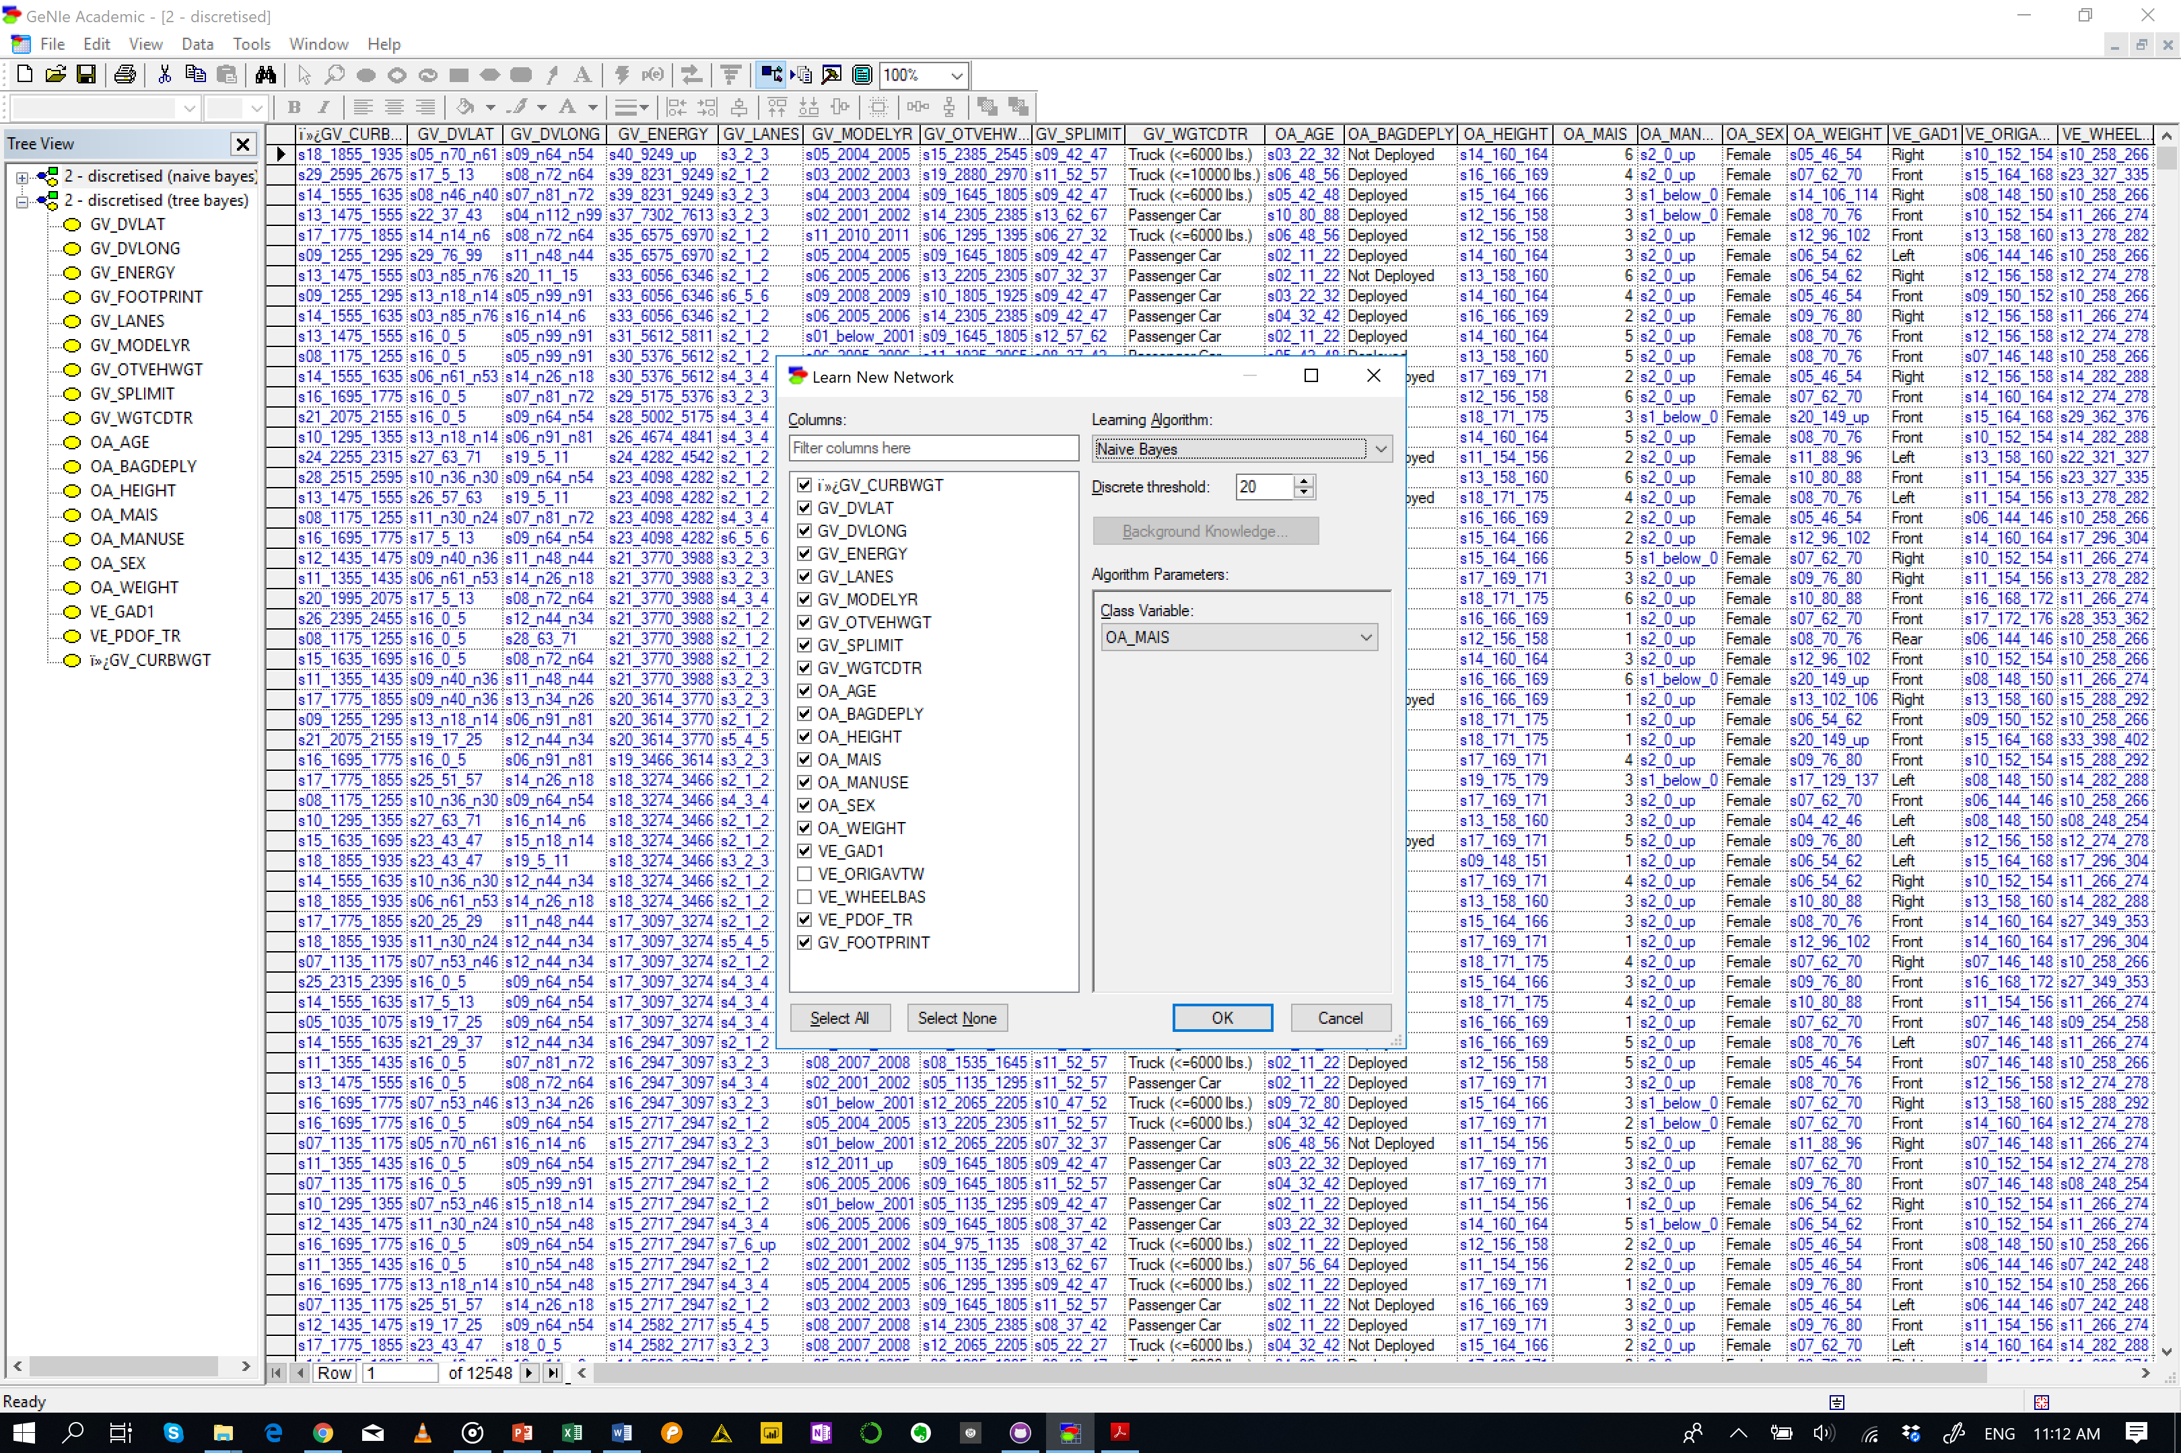
Naïve Bayes

Slide 4
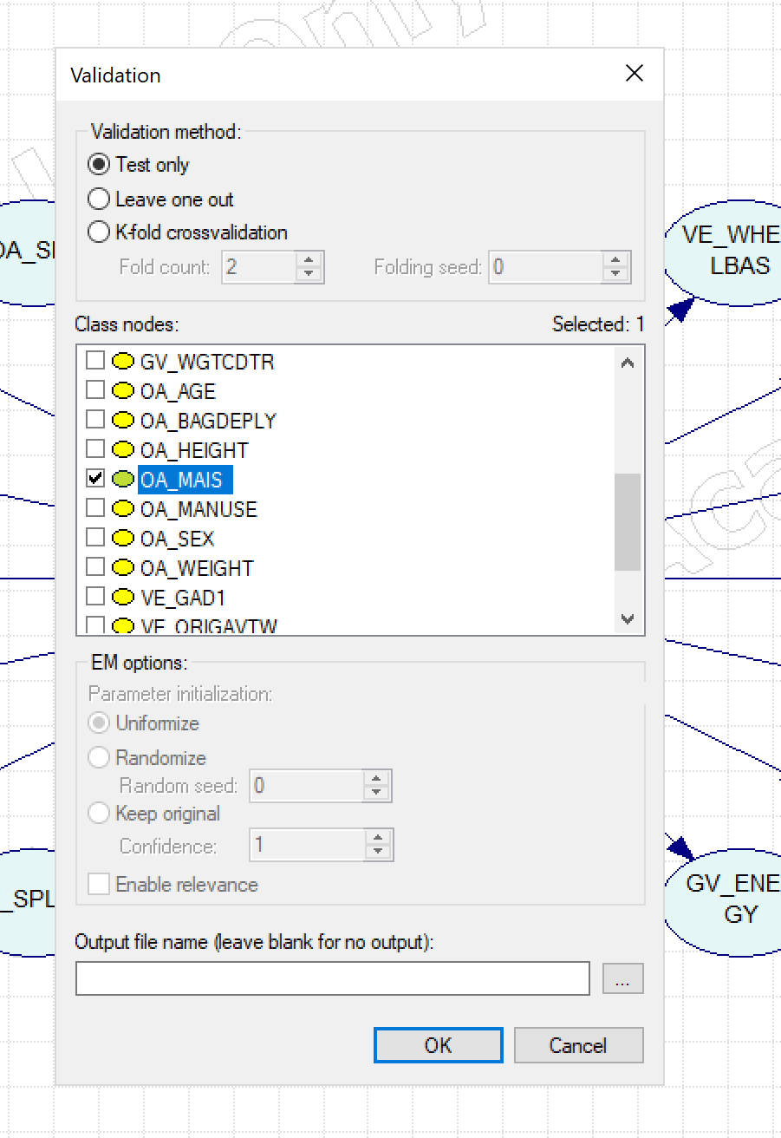
Test
Default
Naïve Bayes
Accuracy
OA_MAIS = 0.545279 (10471/19203)
State0 = 0.599809 (4390/7319)
State1 = 0.639324 (5635/8814)
State2 = 0.0224127 (34/1517)
State3 = 0.286316 (272/950)
State4 = 0.182724 (55/301)
State5 = 0.221198 (48/217)
State6 = 0.435294 (37/85)
 |  | Predicted
 |  | s1_below_0 | s2_0_1 | s3_1_2 | s4_2_3 | s5_3_4 | s6_4_5 | s7_5_up
Actual | s1_below_0 | 4390 | 2780 | 14 | 103 | 20 | 11 | 1
 | s2_0_1 | 2683 | 5635 | 73 | 335 | 47 | 28 | 13
 | s3_1_2 | 270 | 949 | 34 | 200 | 35 | 11 | 18
 | s4_2_3 | 90 | 477 | 24 | 272 | 36 | 32 | 19
 | s5_3_4 | 22 | 123 | 6 | 67 | 55 | 14 | 14
 | s6_4_5 | 9 | 67 | 2 | 58 | 19 | 48 | 14
 | s7_5_up | 4 | 12 | 1 | 20 | 6 | 5 | 37

Slide 5
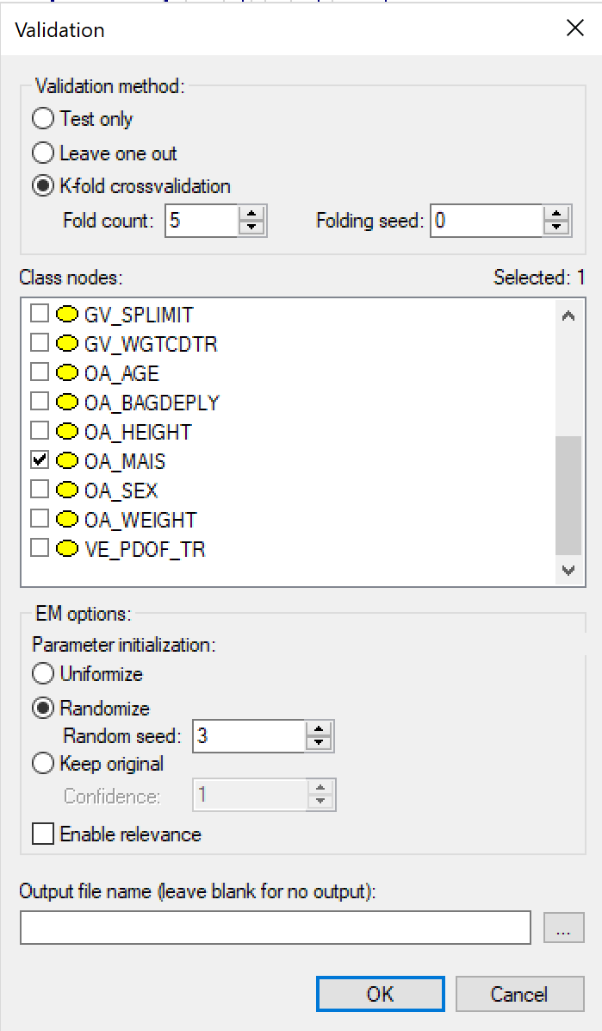
Test
K-fold (5)
Naïve Bayes
Accuracy
OA_MAIS = 0.535281 (10279/19203)
State0 = 0.595163 (4356/7319)
State1 = 0.632516 (5575/8814)
State2 = 0.0243902 (37/1517)
State3 = 0.243158 (231/950)
State4 = 0.109635 (33/301)
State5 = 0.142857 (31/217)
State6 = 0.188235 (16/85)
 |  | Predicted
 |  | s1_below_0 | s2_0_1 | s3_1_2 | s4_2_3 | s5_3_4 | s6_4_5 | s7_5_up
Actual | s1_below_0 | 4356 | 2804 | 23 | 97 | 27 | 11 | 1
 | s2_0_1 | 2732 | 5575 | 91 | 316 | 59 | 30 | 11
 | s3_1_2 | 269 | 946 | 37 | 194 | 39 | 15 | 17
 | s4_2_3 | 93 | 483 | 44 | 231 | 39 | 33 | 27
 | s5_3_4 | 23 | 123 | 13 | 73 | 33 | 23 | 13
 | s6_4_5 | 9 | 70 | 5 | 59 | 29 | 31 | 14
 | s7_5_up | 4 | 12 | 3 | 29 | 8 | 13 | 16

Slide 6
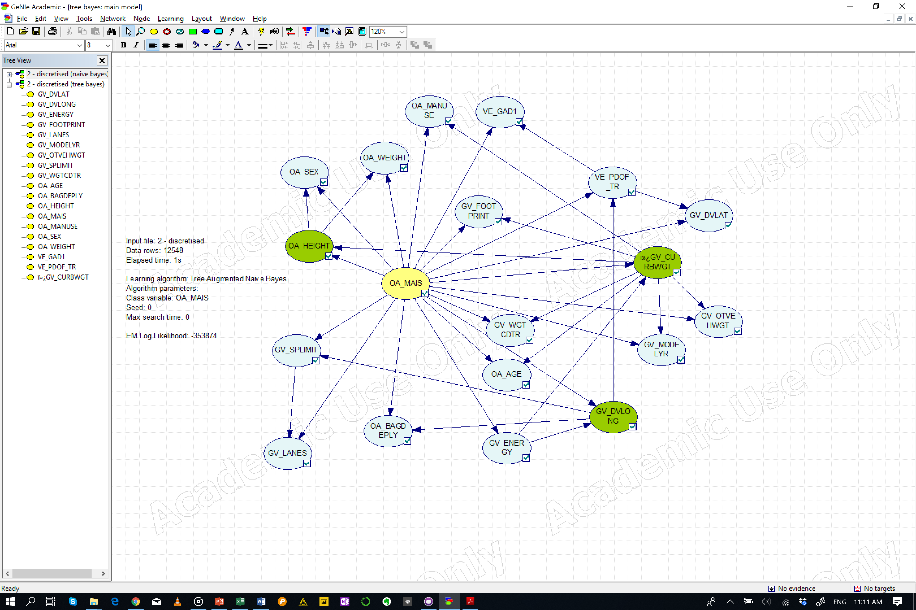
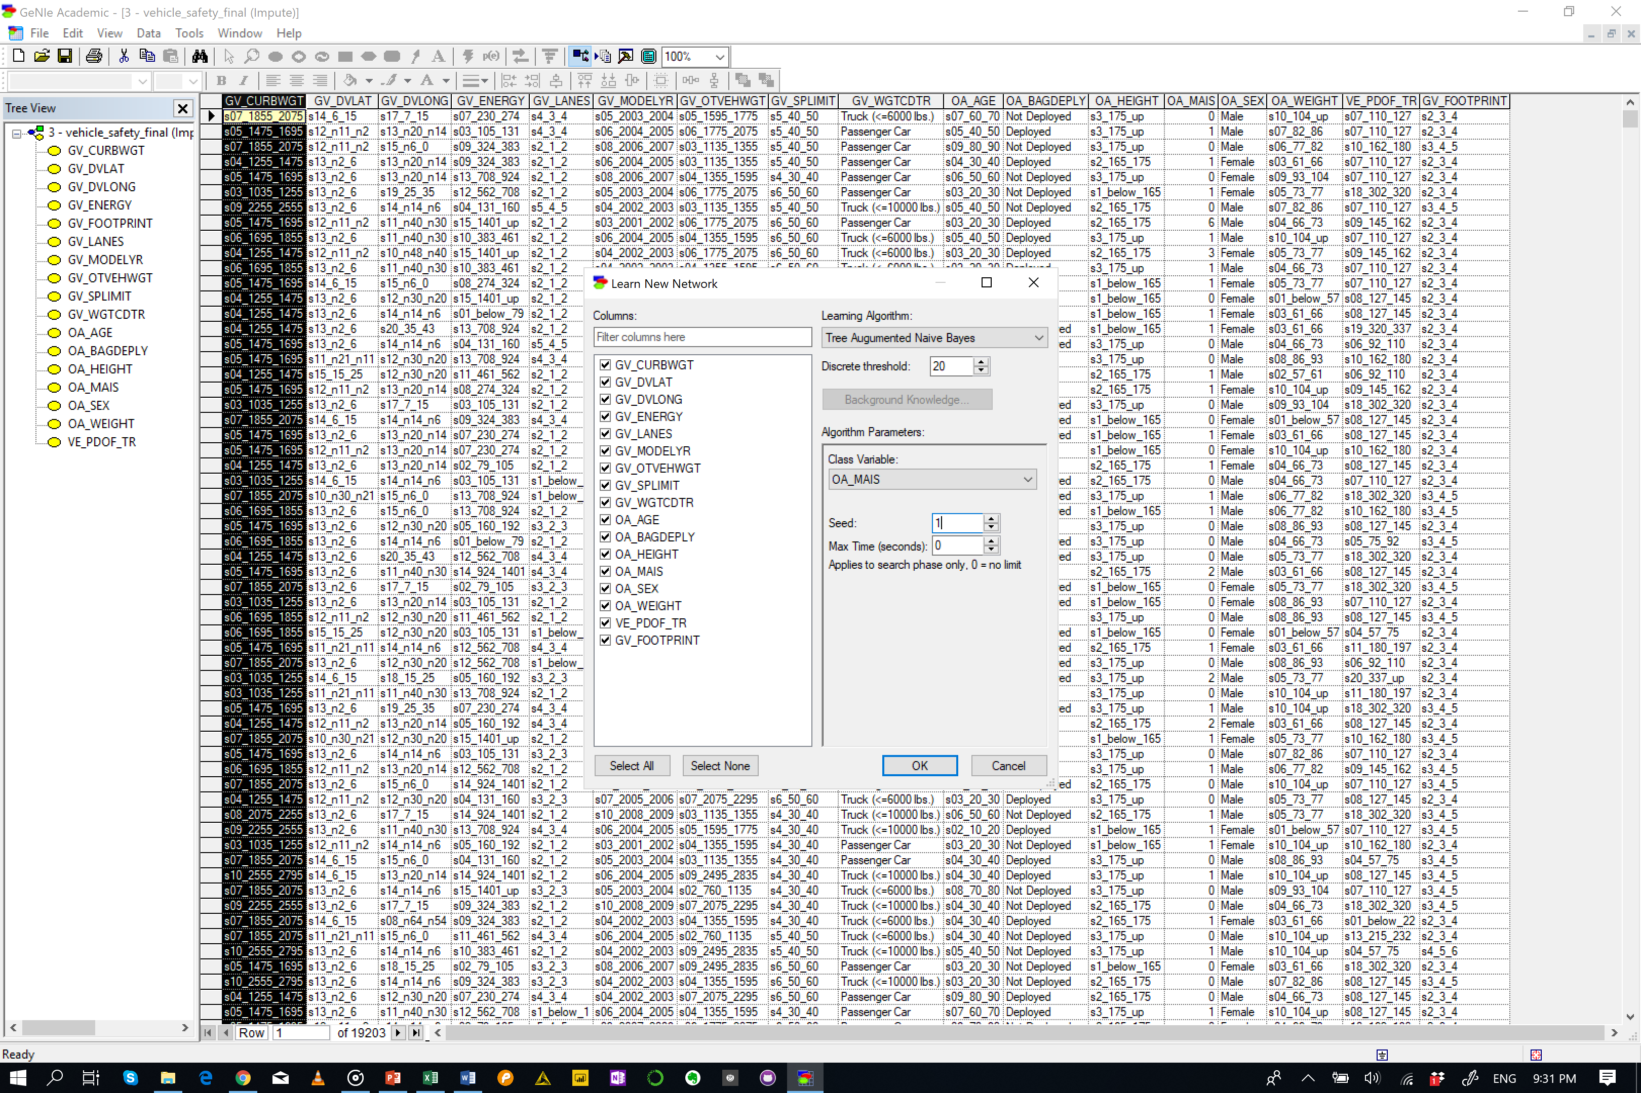
Tree Augmented Bayesian Networks

Slide 7
Test
Default
Tree Augmented Bayes
Accuracy
OA_MAIS = 0.605947 (11636/19203)
State0 = 0.634103 (4641/7319)
State1 = 0.689017 (6073/8814)
State2 = 0.162821 (247/1517)
State3 = 0.346316 (329/950)
State4 = 0.501661 (151/301)
State5 = 0.59447 (129/217)
State6 = 0.776471 (66/85)
 |  | Predicted
 |  | s1_below_0 | s2_0_1 | s3_1_2 | s4_2_3 | s5_3_4 | s6_4_5 | s7_5_up
Actual | s1_below_0 | 4641 | 2522 | 52 | 74 | 14 | 11 | 5
 | s2_0_1 | 2289 | 6073 | 127 | 233 | 60 | 29 | 3
 | s3_1_2 | 250 | 879 | 247 | 93 | 25 | 18 | 5
 | s4_2_3 | 90 | 433 | 42 | 329 | 28 | 25 | 3
 | s5_3_4 | 16 | 83 | 16 | 25 | 151 | 10 | 0
 | s6_4_5 | 4 | 50 | 7 | 15 | 10 | 129 | 2
 | s7_5_up | 2 | 4 | 1 | 9 | 2 | 1 | 66

Slide 8
Test
K-fold (5)
Tree Augmented Bayes
Accuracy
OA_MAIS = 0.527418 (10128/19203)
State0 = 0.571116 (4180/7319)
State1 = 0.633991 (5588/8814)
State2 = 0.0613052 (93/1517)
State3 = 0.168421 (160/950)
State4 = 0.159468 (48/301)
State5 = 0.184332 (40/217)
State6 = 0.223529 (19/85)
 |  | Predicted
 |  | s1_below_0 | s2_0_1 | s3_1_2 | s4_2_3 | s5_3_4 | s6_4_5 | s7_5_up
Actual | s1_below_0 | 4180 | 2934 | 75 | 87 | 22 | 11 | 10
 | s2_0_1 | 2622 | 5588 | 213 | 270 | 80 | 39 | 2
 | s3_1_2 | 290 | 952 | 93 | 127 | 32 | 18 | 5
 | s4_2_3 | 107 | 516 | 77 | 160 | 46 | 37 | 7
 | s5_3_4 | 27 | 122 | 35 | 54 | 48 | 11 | 4
 | s6_4_5 | 10 | 71 | 26 | 44 | 22 | 40 | 4
 | s7_5_up | 8 | 17 | 8 | 15 | 7 | 11 | 19

Slide 9
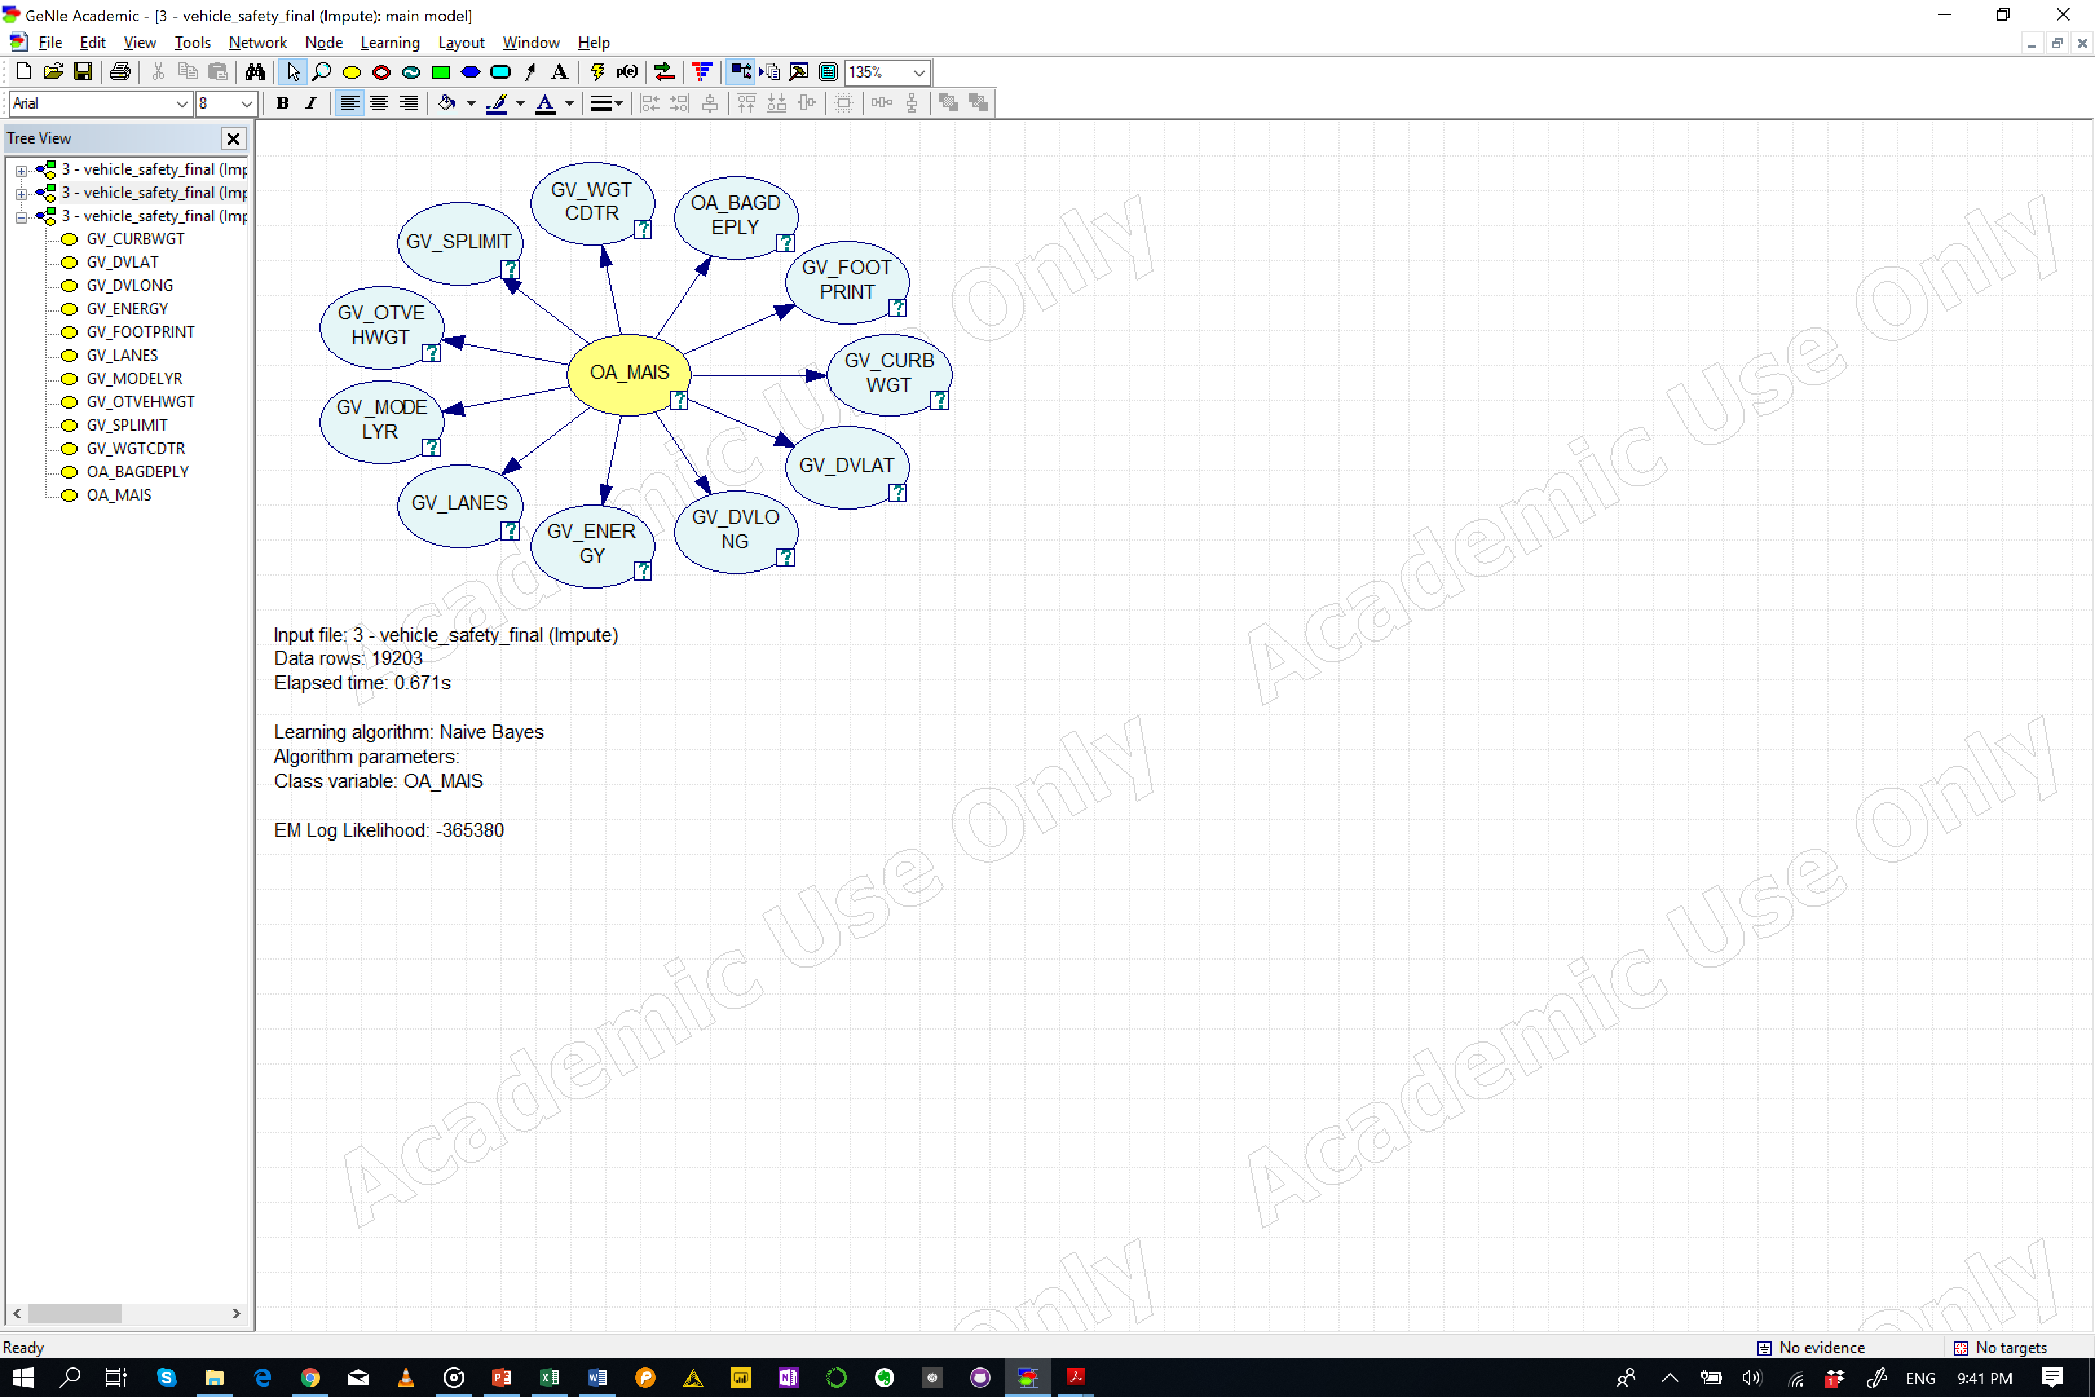
Naïve Bayes

Slide 10
Test
Default
Naïve Bayes
Accuracy
OA_MAIS = 0.531427 (10205/19203)
State0 = 0.595573 (4359/7319)
State1 = 0.619242 (5458/8814)
State2 = 0.0177983 (27/1517)
State3 = 0.270526 (257/950)
State4 = 0.112957 (34/301)
State5 = 0.207373 (45/217)
State6 = 0.294118 (25/85)
 |  | Predicted
 |  | s1_below_0 | s2_0_1 | s3_1_2 | s4_2_3 | s5_3_4 | s6_4_5 | s7_5_up
Actual | s1_below_0 | 4359 | 2843 | 12 | 84 | 12 | 8 | 1
 | s2_0_1 | 2929 | 5458 | 31 | 334 | 30 | 22 | 10
 | s3_1_2 | 253 | 994 | 27 | 191 | 22 | 14 | 16
 | s4_2_3 | 72 | 542 | 10 | 257 | 21 | 27 | 21
 | s5_3_4 | 18 | 144 | 4 | 69 | 34 | 16 | 16
 | s6_4_5 | 7 | 91 | 0 | 50 | 13 | 45 | 11
 | s7_5_up | 2 | 20 | 1 | 26 | 4 | 7 | 25

Slide 11
Test
K-fold (5)
Naïve Bayes
Accuracy
OA_MAIS = 0.535281 (10279/19203)
State0 = 0.595163 (4356/7319)
State1 = 0.632516 (5575/8814)
State2 = 0.0243902 (37/1517)
State3 = 0.243158 (231/950)
State4 = 0.109635 (33/301)
State5 = 0.142857 (31/217)
State6 = 0.188235 (16/85)
 |  | Predicted
 |  | s1_below_0 | s2_0_1 | s3_1_2 | s4_2_3 | s5_3_4 | s6_4_5 | s7_5_up
Actual | s1_below_0 | 4356 | 2804 | 23 | 97 | 27 | 11 | 1
 | s2_0_1 | 2732 | 5575 | 91 | 316 | 59 | 30 | 11
 | s3_1_2 | 269 | 946 | 37 | 194 | 39 | 15 | 17
 | s4_2_3 | 93 | 483 | 44 | 231 | 39 | 33 | 27
 | s5_3_4 | 23 | 123 | 13 | 73 | 33 | 23 | 13
 | s6_4_5 | 9 | 70 | 5 | 59 | 29 | 31 | 14
 | s7_5_up | 4 | 12 | 3 | 29 | 8 | 13 | 16

Slide 12
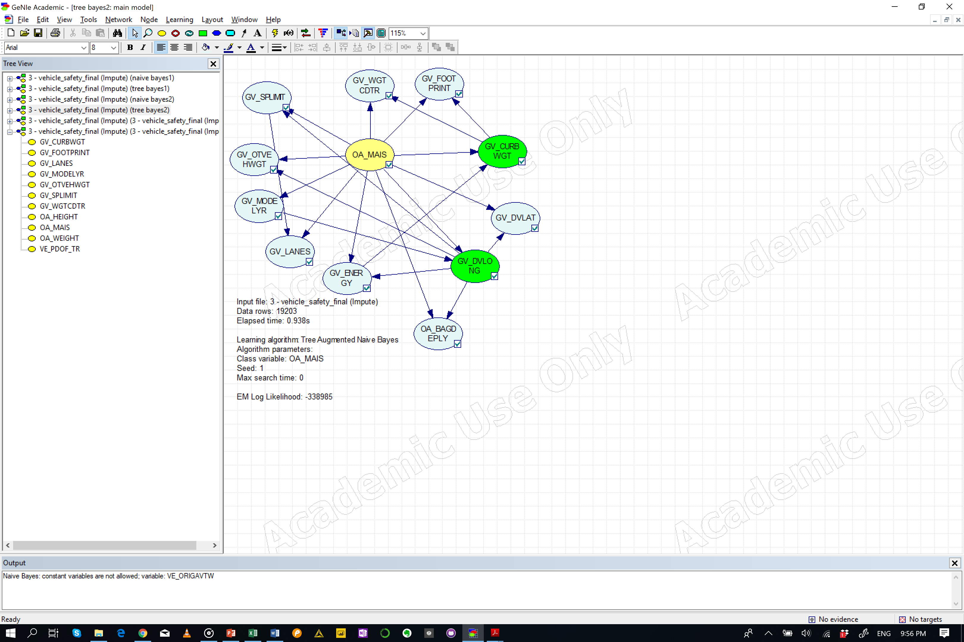
Tree Augmented Bayesian Networks

Slide 13
Test
Default
Tree Augmented Bayes
Accuracy
OA_MAIS = 0.577931 (11098/19203)
State0 = 0.591201 (4327/7319)
State1 = 0.690606 (6087/8814)
State2 = 0.102835 (156/1517)
State3 = 0.269474 (256/950)
State4 = 0.398671 (120/301)
State5 = 0.456221 (99/217)
State6 = 0.623529 (53/85)
 |  | Predicted
 |  | s1_below_0 | s2_0_1 | s3_1_2 | s4_2_3 | s5_3_4 | s6_4_5 | s7_5_up
Actual | s1_below_0 | 4327 | 2871 | 33 | 52 | 23 | 12 | 1
 | s2_0_1 | 2444 | 6087 | 60 | 127 | 49 | 42 | 5
 | s3_1_2 | 233 | 1016 | 156 | 65 | 28 | 14 | 5
 | s4_2_3 | 75 | 536 | 29 | 256 | 29 | 20 | 5
 | s5_3_4 | 21 | 115 | 12 | 23 | 120 | 9 | 1
 | s6_4_5 | 6 | 75 | 8 | 19 | 8 | 99 | 2
 | s7_5_up | 2 | 14 | 1 | 8 | 1 | 6 | 53

Slide 14
Test
K-fold (5)
Tree Augmented Bayes
Accuracy
OA_MAIS = 0.527418 (10128/19203)
State0 = 0.571116 (4180/7319)
State1 = 0.633991 (5588/8814)
State2 = 0.0613052 (93/1517)
State3 = 0.168421 (160/950)
State4 = 0.159468 (48/301)
State5 = 0.184332 (40/217)
State6 = 0.223529 (19/85)
 |  | Predicted
 |  | s1_below_0 | s2_0_1 | s3_1_2 | s4_2_3 | s5_3_4 | s6_4_5 | s7_5_up
Actual | s1_below_0 | 4180 | 2934 | 75 | 87 | 22 | 11 | 10
 | s2_0_1 | 2622 | 5588 | 213 | 270 | 80 | 39 | 2
 | s3_1_2 | 290 | 952 | 93 | 127 | 32 | 18 | 5
 | s4_2_3 | 107 | 516 | 77 | 160 | 46 | 37 | 7
 | s5_3_4 | 27 | 122 | 35 | 54 | 48 | 11 | 4
 | s6_4_5 | 10 | 71 | 26 | 44 | 22 | 40 | 4
 | s7_5_up | 8 | 17 | 8 | 15 | 7 | 11 | 19

